Slide 1

Department of Software Engineering Software Fault Prediction Using Machine Learning Approaches by Reduced Feature Set
SRM INSTITUTE OF SCIENCE & TECHNOLOGY
FACULTY OF ENGINEERING & TECHNOLOGY
Done By Guided By
Shubham Pratap(RA1611020010045) Mr. C Arun
Tanvi S Chouhan(RA1611020010009) Assistant Professor(O.G.)
Department of Software Engineering

Slide 2
Originality & Innovation:
So in our project, firstly we are taking the data set and reducing the dimensions of the data set so as to have more accurate prediction. So the feature reduction is the highlight of our project.
We tried comparing different algorithms and methods to reduce and extract features, the co-relation matrix to reduce the dimension of the model, but found out that PCA works best for greater dimensional datasets like ours which could have up to 86 dimensions .

Slide 3
What percentage of work was completed as per the original plan at the submission of project report:
We had completed mostly everything before we the submission of our report.
Due to lockdown , we were unable to take up more dimension reduction and more feature selection algorithms so our guide suggested us to not take up more algorithms but to study the ones we were working in depth and increase the accuracy of our project.

Slide 4
Highlight the originality of the project:
Already existing systems did not use any kind of dimension reduction algorithms, which we have used in our project. Also we are comparing the two models of SVM and Naïve bayse, to see which of them is more accurate and has better performance. We have successfully increased the efficiency of the system and reduce 22 dimensions to 2 or 3.

Slide 5
In your team's view what is the innovation / new idea / concept / technique that can be highlighted in your project:
The new idea that we came up with, was using a feature reduction method in pre-processing. So out of the 22 attributes/dimensions that we have we can narrow it down to 3 or 4 major independent dimensions. And then for feature selection we are using two approaches(NB and SVM) and comparing them.

Slide 6
What mathematical / software Tools were used for design / analysis / simulation/ testing etc:
Software used:
Anaconda Navigator
Jupiter Notebook
Python 3
Star Unified Modelling Language (UML)

Slide 7
State the contribution made by the individual team members:

Slide 8
Percentage of work done using SRM Facilities (name the laboratories /centres):
We did not use the SRM Facilities.
Percentage of work done using external facilities (Specify the facilities):
We did all the work on our personal systems.

Slide 9
Challenges faced during the execution of the project and how it was resolved:
The basic challenge was getting a reliable data set that is not biased, is heterogenous and has no false data.
So we took NASA (Promise data repository) for the unbiased datasets.
And also to select the reduction algorithm and since we are new to ML it was even more tough, we anyhow went through different websites, videos and blogs. And then compared the advantages and disadvantages of PCA and co-relation matrix.

Slide 10
Due to unexpected lockdown and based on the advice of your guide, what are the modifications / deviations you did in order to shape the project work to completion:
Due to lockdown , we were unable to take up more dimension reduction and more feature selection algorithms so our guide suggested us to not take up more algorithms but to study the ones we were working in depth and increase the accuracy of our project.

Slide 11
Abstract
Predicting software fault proneness is very important as the process of fixing these faults after the release is very costly and time-consuming.
In order to predict software fault proneness, many machine learning algorithm were used on several datasets, using different metrics as features.
Related work suggested that using change metrics leads to the highest accuracy in prediction. In addition, some algorithms perform better than others in certain circumstances.

Slide 12
LITERATURE SURVEY
S. No. | Paper Title | Year | Algorithm | Conclusion
1. | Software Metrics for Fault Prediction Using Machine Learning Approaches | 2017 | Random Forest Naive Bayes | In this paper, software metric is proved as one efficient source to provide fault predictive model. In despite of every type of metric can be used to estimate fault proneness module, class level metric shows better prediction performance compare to method level metric
2 | APPLICATION OF DEEP LEARNING AND DIMENSIONALITY REDUCTION IN SOFTWARE DEFECT PREDICTION | 2019 | ML AND Dimensionality Reduction (LDA, PCA, Kernel PCA) | In this paper, extract a set of expressive features from an initial set of basic change measures using Artificial Neural Network, and then train a classifier based on the extracted features using Decision tree and compare it to three other methods wherein features are extracted from a set of initial change measures using dimensionality reduction techniques

Slide 13
3. | Empirical Studies of a Two-Stage Data Preprocessing Approach for Software Fault Prediction | 2011 | novel threshold-based clustering algorithm, Novel Algorithm | In this paper, we use two-stage data preprocessing approach, which incorporates both feature selection and instance reduction, to improve the quality of software datasets used by classification models for software fault prediction.”
4. | Applying machine learning to predict software fault proneness using change metrics, static code metrics, and a combination of them | 2014 | Logistic regression, Naive Bayes, and J48 Algorithm | This study shows us to compare different machine learning algorithm for software fault prediction. It uses different dataset from eclipse and in this paper they found that using the reduced feature set of metrics produces slightly higher accuracy than using all other metrics

Slide 14
5. | Machine learning based software fault prediction utilizing source code metrics | 2018 | Random Forest technique | In this proposed system, they studied on different machine learning algorithm like Decision tree, Naïve Bayes, Support Vector Machine… to check the feature selection process in order to predict the software fault prediction using different metrics. They analyzed the performance of the different machine learning approaches.
6. | An Empirical Study on Software Defect Prediction with a Simplified Metric Set | 2014 | Naive Bayes | In this paper, they aimed at predicting how a predictor based on simplified metrics set in build and used for both CPDP and WPDP. It built with a different metrics set which work well and is very useful in case of limited resources.”.

Slide 15
7. | Dynamic Selection of Classifiers in Bug Prediction: An Adaptive Method | 2017 | Machine Learning Algo and Logistic regression | In this paper, they proposed ASCI, which is an approach able to dynamically recommend the classifier to use and detect the bug prediction based on structural characteristics
8. | The Practice of predictive analytics in software | 2015 | Naïve Bayes, SVM(Support Vector Machine) | In this paper, effective mechanisms have been used for software defect prediction by mining the data containing historical records. Here, we used Naïve Bayes, Support Vector Machine (SVM) and classifiers of software defect. In this study, we also present comparative study of different classifiers to measure the performance based on accuracy rate

Slide 16
9. | Support-vector networks | 1995 | Naïve Bayes and SVM Algorithm | In this paper The support-vector network is a new learning machine for two-group classification problems. The machine conceptually implements the following idea: input vectors are non-linearly mapped to a very high-dimension feature space. In this feature space a linear decision surface is constructed.
10. | A Tutorial on Support Vector Machines for Pattern Recognition | 1998 | SVM Algorithm | In this study they describe linear Support Vector Machines (SVMs) for separable and non-separable data, working through a non-trivial example in detail. We describe a mechanical analogy, and discuss when SVM solutions are unique and when they are global.

Slide 17
Existing Work
With this existing method we use the SVM Algorithm to calculate such software specifications.
SVM Algorithm is a very efficient technique for classifying all information provided. In that extreme the time of the beginning of time.
Software specification begins with large, large numbers of distributed control system and distributed data, and seeks to explore complex and efficient relationships between data.
Existing system demonstrates SVM [Support Vector Machine] theorem with Big Data conversion symbols, and uses Big Data multiplication model.

Slide 18
Proposed Methodology:
Software defect to predict big data or data set is provided as input to the system. Unpublished voluminous input data can be found in Algorithms for SVM algorithm and Gaussian Naïve Bayse algorithm.
Examining Big Data, the proposed system analysed several challenges to data, model, and program data. To support the Big industrial operation, highly efficient computing platforms are required, forcing the systematic architecture to harness the full potential of Big Data.
So we are proposing to have the big data pre processed and hence use the different reduction algorithms and have a reduced set to further analyse, test and train the model that we are going to create using naïve bayse and SVM algorithm.
Further we are going to compare the accuracy of two models.

Slide 19
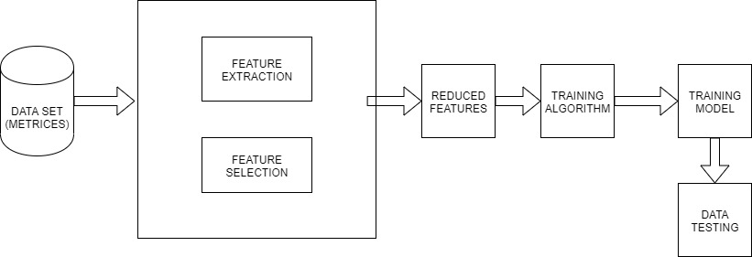
Architecture Design & Modules Details
SYSTEM ARCHITECTURE

Slide 20
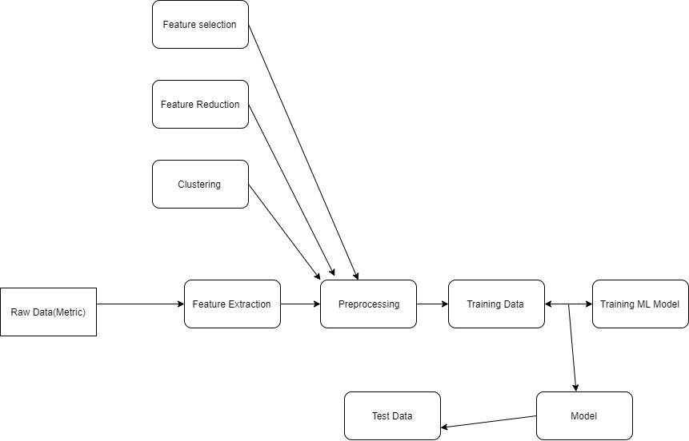
DATA FLOW DIAGRAM

Slide 21
Use case Diagram:
Software Data
Data set collection
User select query
USER
Big Query Form
Jupiter Notebook Tool
PICKLE...n()
DESK()
Result

Slide 22
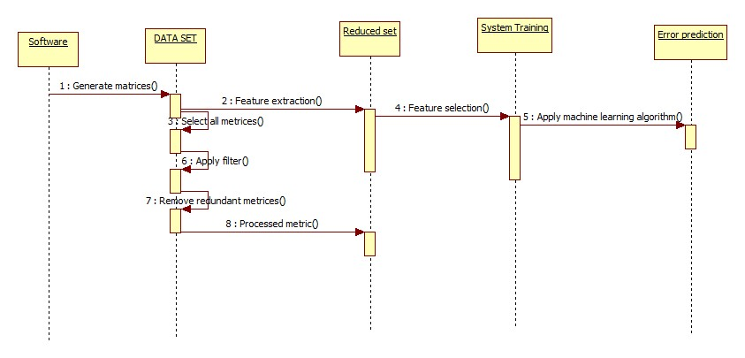
Sequence Diagram

Slide 23
Class Diagram:
TOOL ENGINE
MapReduce
+URL
+index
+Dataset
+Data set
+Big query()
+PICKLE()
+PICKLE()
+DISK()
Software Data
+Profile
+input query
+Authenticate()
+query process()
Algorithms
+SVM
+Classifier
+Dispaly()

Slide 24
MODULES:
Data Collection
Pre-Processing
Feature extraction
Classification
Efficiency Calculation

Slide 25
DATA COLLECTION
We have taken our data from the NASA Promise data repository available for the public use.
A lot of parameters are considered while predicting whether a software is buggy or not which include number of lines in the code, its complexity, the number of operators and operands used in the code and other factors. We have considered a set of 22 initial features to predict whether the software is buggy.
For this comparison we have used 5 datasets

Slide 26
DATA Pre-Processing:
So in our project we have done data pre-processing in order to avoid noise and enhance the accuracy of prediction
For data pre processing, we studied our data closely and then processed the data and removed the null values.
After removing the null values we have labelled our data into two parts the observations and result part that is X and Y.
Further we have converted the String value in Y part to 0 and 1 to make the data more easy to work with.

Slide 27
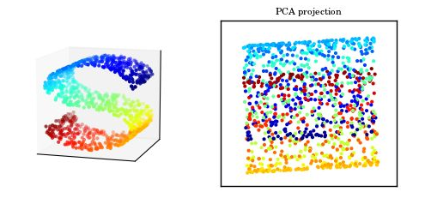
Feature Extraction:
Feature extraction is the technique to extract the most important, or the feature which are independent of each other.
We have used Kernal Principal Component Analysis(non-linear) to reduce the dimensions from 21 to 6, this has hence improved the accuracy and made it easy for the big data to be handled.

Slide 28
Classification:
The classification we have used Gaussian Naïve bayse and Support Vector Machine to have a comparison.
Bayse theorem is based on conditional probability. The conditional probability helps us calculating the probability that something will happen, given that something else has already happened
A Gaussian Naive Bayes algorithm is a special type of NB algorithm. It’s specifically used when the features have continuous values. It’s also assumed that all the features are following a gaussian distribution i.e, normal distribution.

Slide 29
A support vector machine (SVM) is machine learning algorithm that analyzes data for classification and regression analysis. SVM is a supervised learning method that looks at data and sorts it into one of two categories.
So using these two we have created the model. We divide the data into training and testing where we 80% of data we kept for training and rest 20% for testing.

Slide 30
Efficiency Calculation
According to the predictions made by both the models we calculated the accuracy, precision , recall and f1 score.
F1 scores are weighted average of Precision and Recall taking into consideration both False Positives and False Negatives.
Finally we got the confusion matrix for all the datasets individually and also the roc curves.

Slide 31
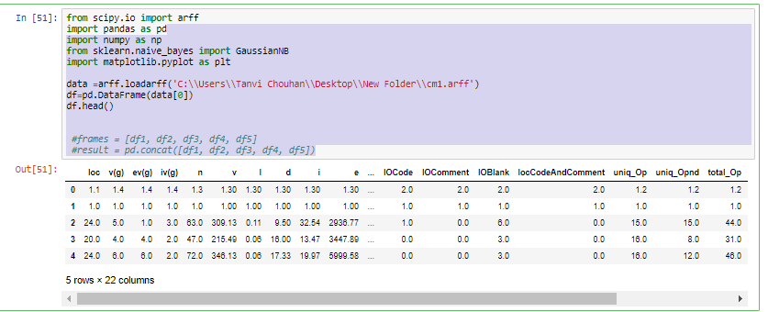
Implementation
Open data repository from NASA Promise data repository.
PRE PROCESSING : defining all the datasets

Slide 32
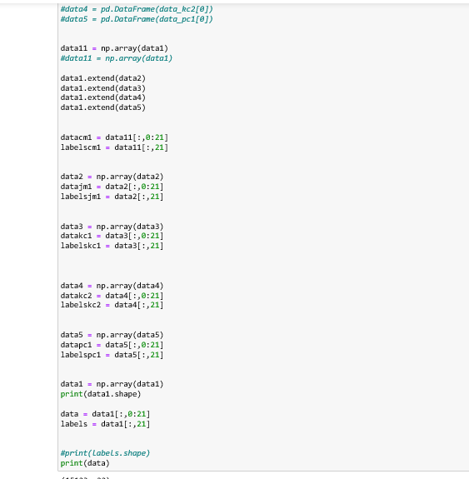
Labelling and reducing the data

Slide 33
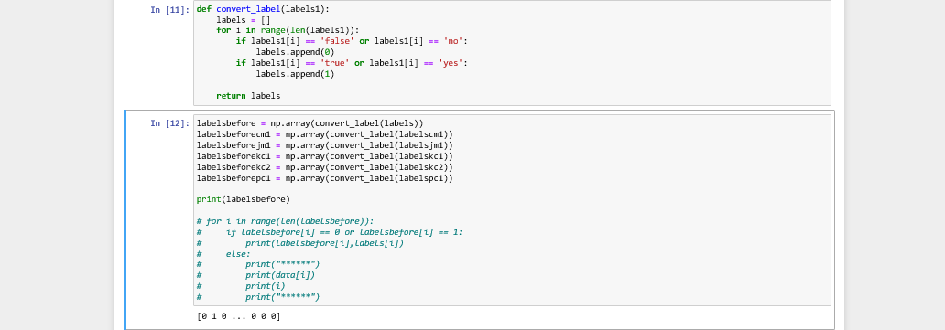
Labelling false/true or no/yes as zero and one.
Storing values in array.

Slide 34
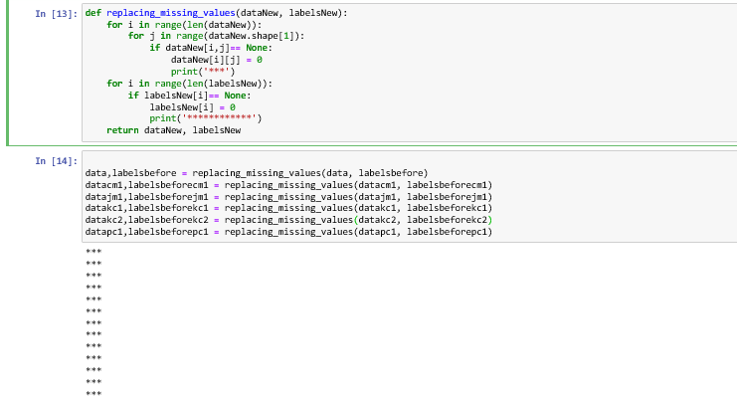
Removing the noise. By removing null values from the data.

Slide 35
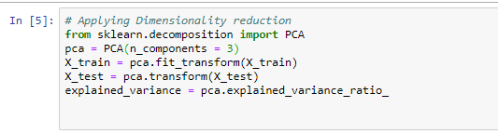
Dimension Reduction
We are reducing the dimension using PCA

Slide 36
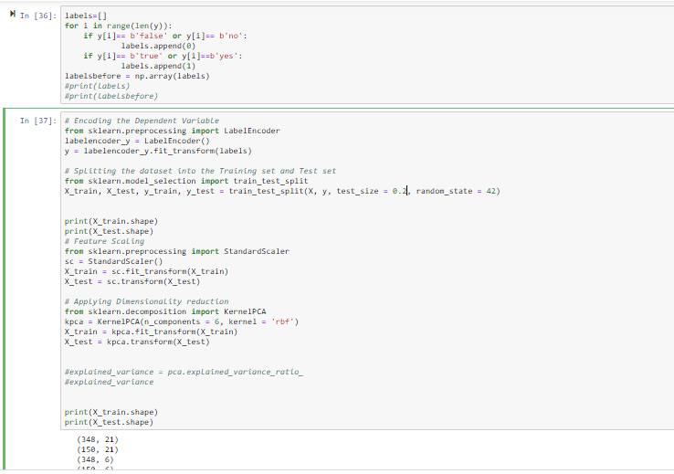
Assigning 20% of data to testing and 80% to training . Shuffling and splitting of data.

Slide 37
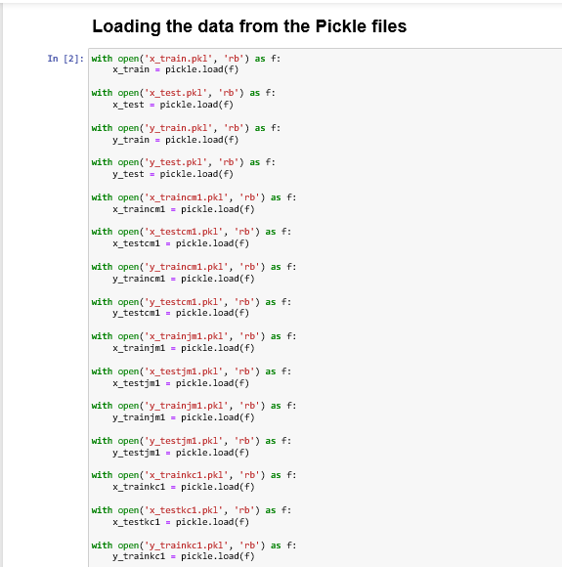
Feature extraction:
Loading the data from pickle files(deserializing)

Slide 38
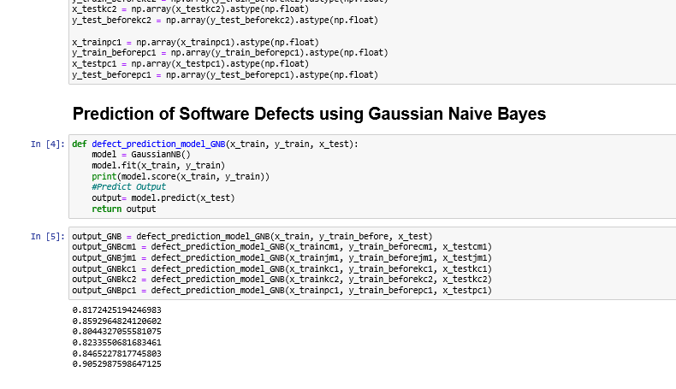
Using the feature extraction algorithm Naïve Bayes to make the model.

Slide 39
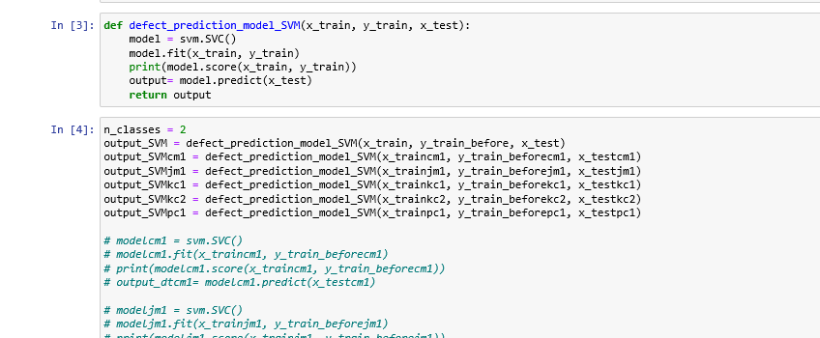
Using the feature extraction (SVM) to make the model

Slide 40
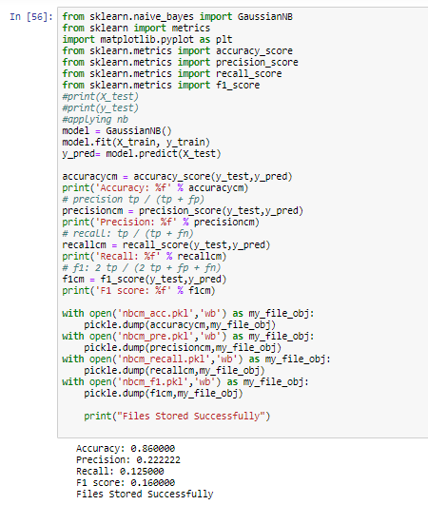
Efficiency Calculation :
Calculating accuracy using Naïve bayes:

Slide 41
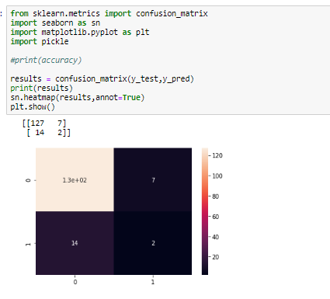
Confusion matrix using Naïve Bayes:

Slide 42
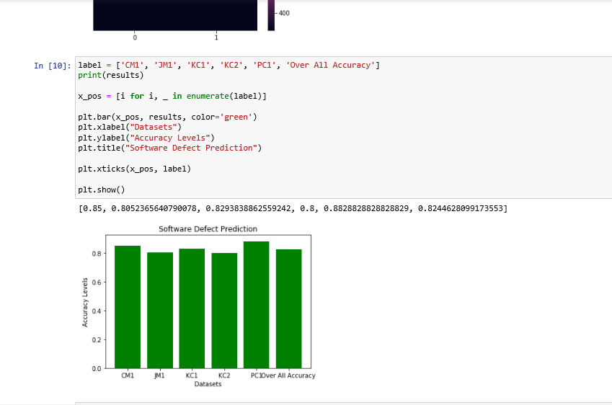
Accuracy levels of different datasets using naïve bayes.

Slide 43
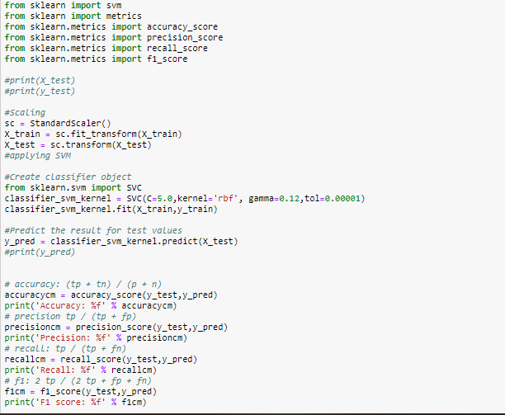
Calculating accuracy using SVM:

Slide 44
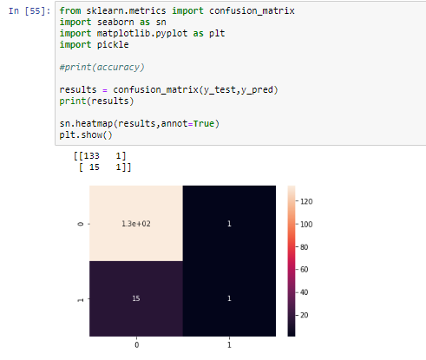
Confusion matrix using SVM:

Slide 45
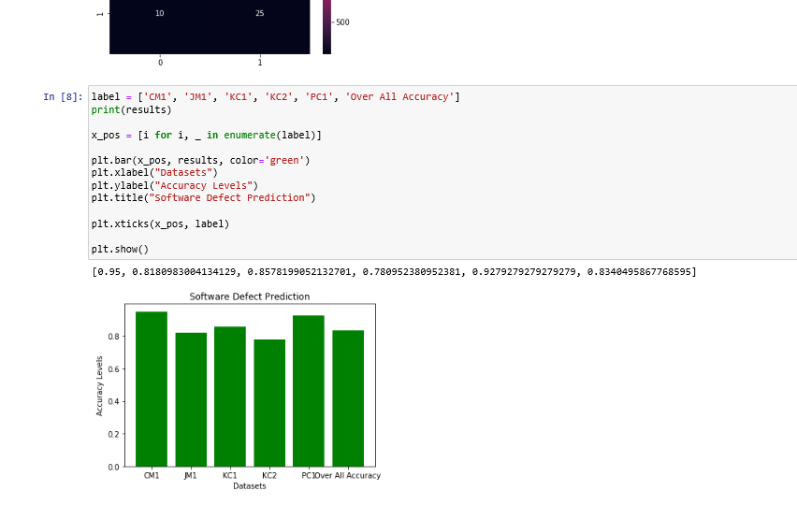
Accuracy levels of different datasets using SVM.

Slide 46
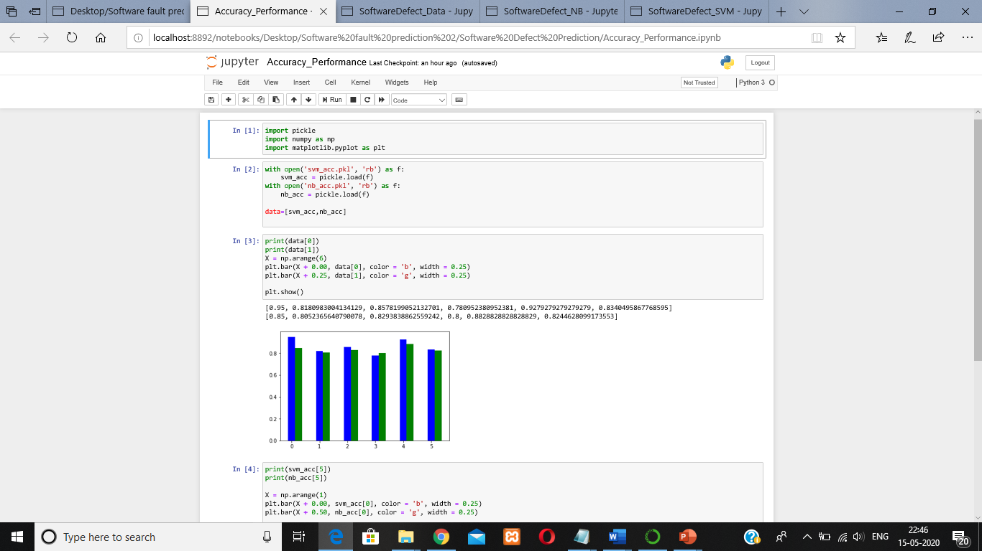
Comparing accuracy performance between naïve bayse and SVM:

Slide 47
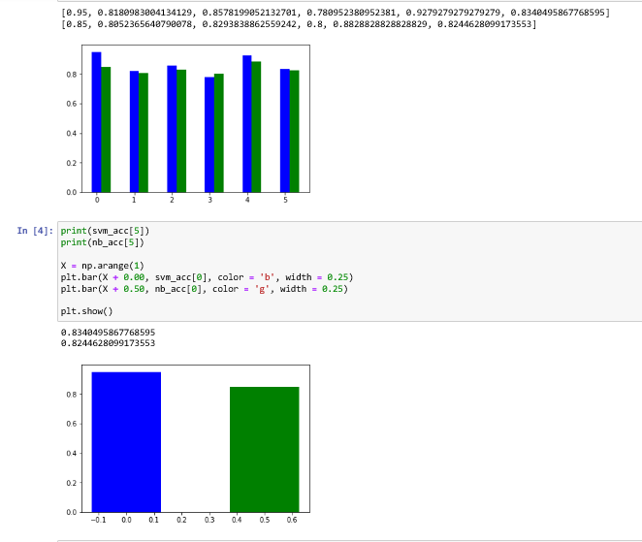
Blue-SVM
Green-NB

Slide 48
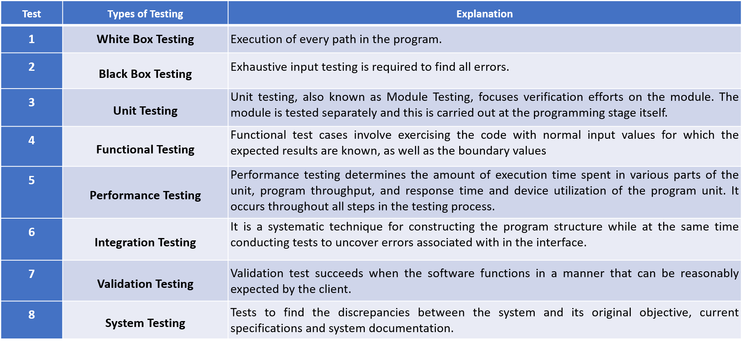
Verification & Validation:

Slide 49
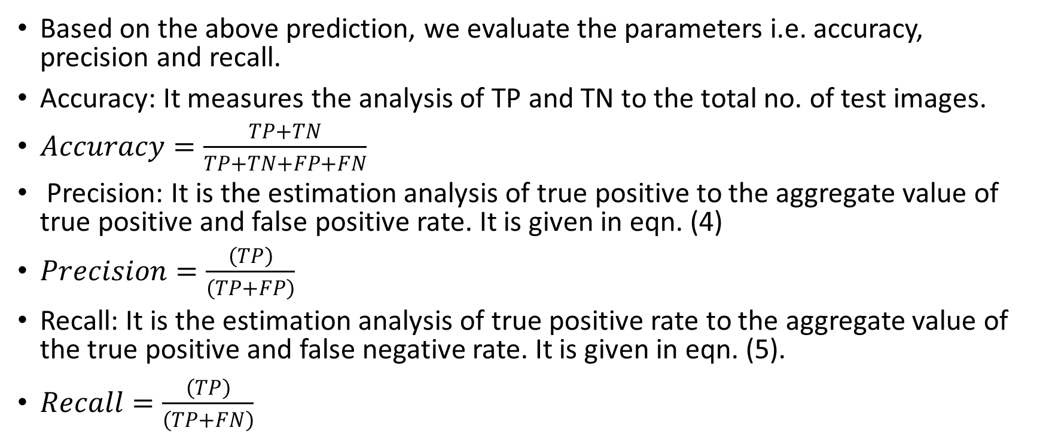
Experiment Result & Analysis:
Based on the above prediction, we evaluate the parameters i.e. accuracy, precision and recall.
Accuracy: It measures the analysis of TP and TN to the total no. of test images.
$Accuracy=\frac{TP+TN}{TP+TN+FP+FN}$
Precision: It is the estimation analysis of true positive to the aggregate value of true positive and false positive rate. It is given in eqn. (4)
$Precision=\frac{\left(TP\right)}{\left(TP+FP\right)}$
Recall: It is the estimation analysis of true positive rate to the aggregate value of the true positive and false negative rate. It is given in eqn. (5).
$Recall=\frac{\left(TP\right)}{\left(TP+FN\right)}$

Slide 50
RESULT ANALYSIS:
For Naïve Bayes Algorithm:
Accuracy: Overall, how often is the classifier correct?
(TP+TN)/total = (127+2)/150 = 0.86
Misclassification Rate: Overall, how often is it wrong?
(FP+FN)/total = (14+7)/150 = 0.14
equivalent to 1 minus Accuracy, also known as "Error Rate"
True Positive Rate: When data is present in dataset, how often does it detect the fault?
TP/present in dataset = 127/134 = 0.947
also known as "Sensitivity" or "Recall"
False Positive Rate: When data is not present in dataset, how often does it detect the fault?
FP/not present in dataset = 14/16 = 0.875
True Negative Rate: When data is not present in dataset, how often does it not detect the fault?
TN/not present in dataset = 2/16 = 0.125
equivalent to 1 minus False Positive Rate, also known as "Specificity"
Precision: When it detects fault, how often is it correct?
TP/Face detected = 127/141 = 0.879

Slide 51
For SVM Algorithm:
Accuracy: Overall, how often is the classifier correct?
(TP+TN)/total = (133+1)/150 = 0.89
Misclassification Rate: Overall, how often is it wrong?
(FP+FN)/total = (15+1)/150 = 0.11
equivalent to 1 minus Accuracy, also known as "Error Rate"
True Positive Rate: When data is present in dataset, how often does it detect the fault?
TP/present in dataset = 133/134 = 0.992
also known as "Sensitivity" or "Recall"
False Positive Rate: When data is not present in dataset, how often does it detect the fault?
FP/not present in dataset = 15/16 = 0.9375
True Negative Rate: When data is not present in dataset, how often does it not detect the fault?
TN/not present in dataset = 1/16 = 0.0625
equivalent to 1 minus False Positive Rate, also known as "Specificity"
Precision: When it detects fault, how often is it correct?
TP/Face detected = 133/148 = 0.898

Slide 52
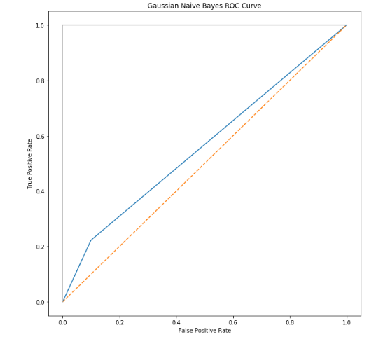
ROC curve for Gaussian Naïve Bayes- Predicted vs Actual(test set)

Slide 53
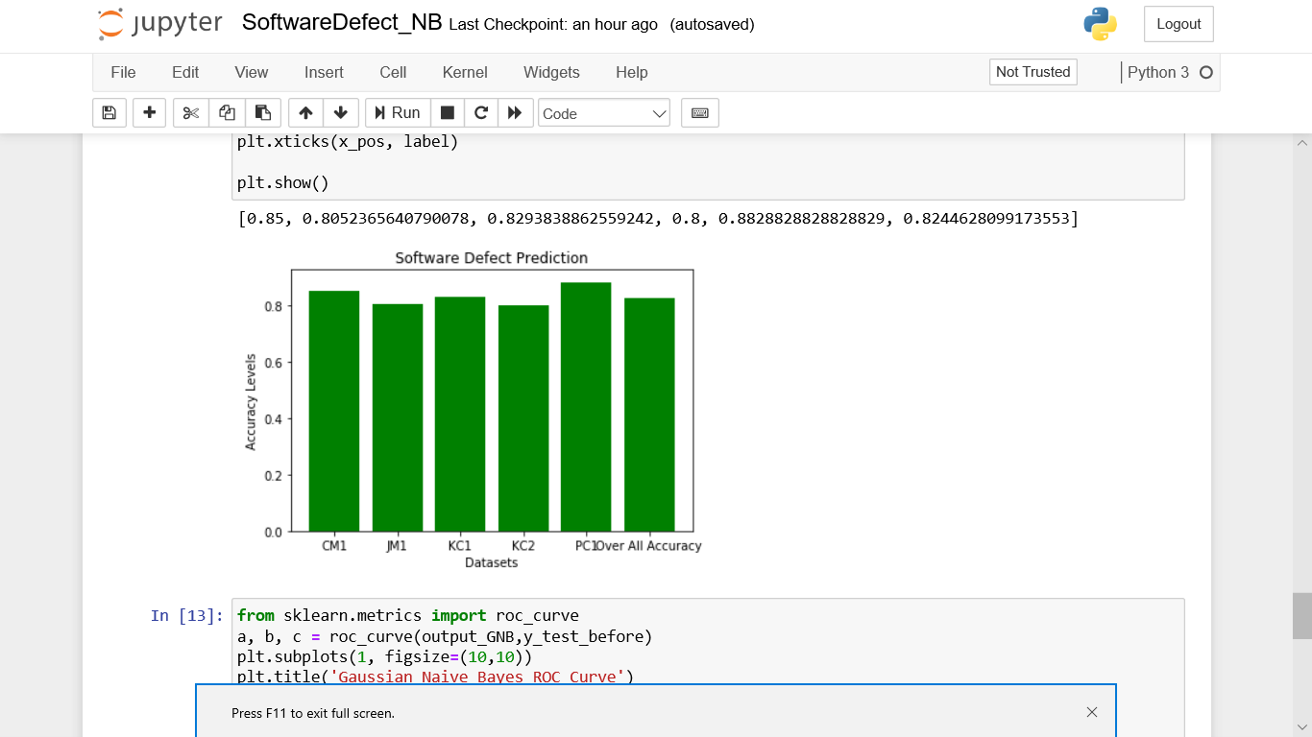
Accuracy Levels of Different datasets using naïve bayes

Slide 54
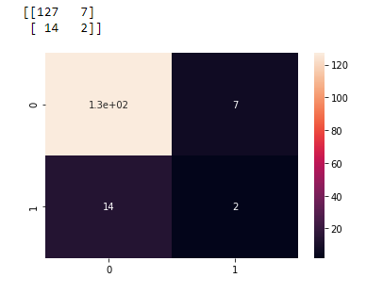
Confusing Matrix Result using Naive Bayes:

Slide 55
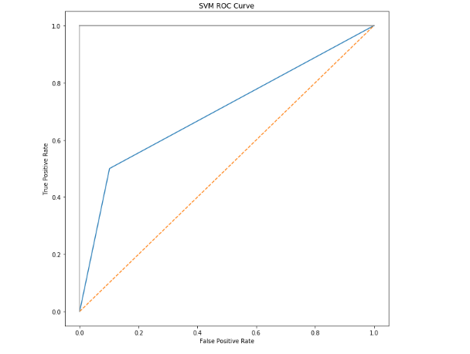
ROC curve for SVM- Predicted vs Actual(test set)

Slide 56
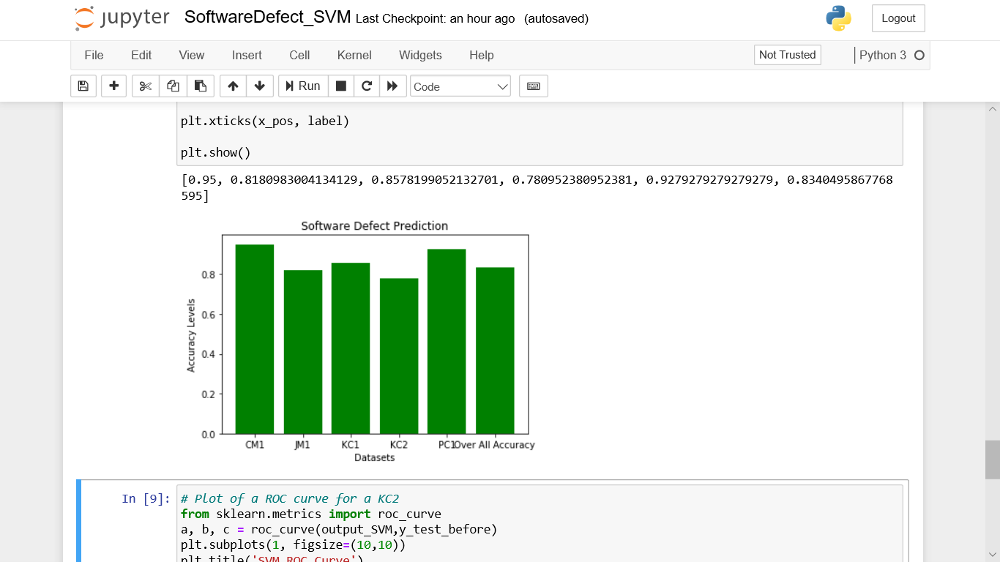
Accuracy Levels of Different datasets using SVM:

Slide 57
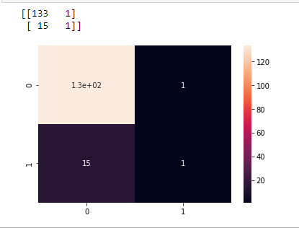
Confusing Matrix Result using SVM:

Slide 58
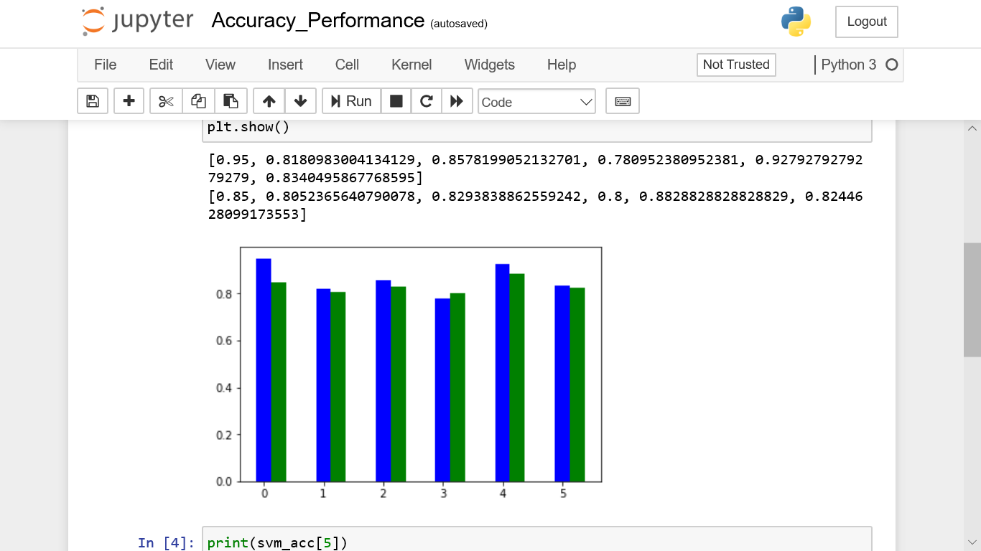
Comparing accuracy performance between naïve bayse and SVM:
Blue-SVM
Green-NB

Slide 59
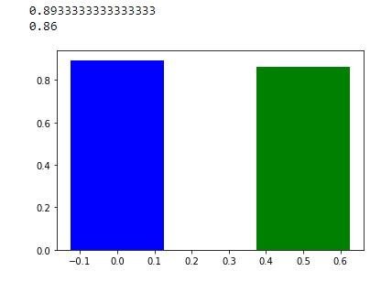
Comparing accuracy performance between Naïve Bayes and SVM:
Blue-SVM
Green-NB

Slide 60
References and Publication Details
1. X. Yang, D. Lo, X. Xia, Y. Zhang, and J. Sun, “Deep learning for just-in-time defect prediction,” in QRS’15: Proc. of the International Conference on Software Quality, Reliability and Security , 2015.
2. Y. Kamei, E. Shihab, B. Adams, A. E. Hassan, A. Mockus, A. Sinha, and N. Ubayashi, “A large-scale empirical study of just-in-time quality assurance,” TSE , vol. 39, no. 6, pp. 757–773, 2013.
3. T. Jiang, L. Tan, and S. Kim, “Personalized defect prediction,” in ASE , 2013, pp. 279–28.
4. M. Tan, L. Tan, S. Dara, and C. Mayeux, “Online defect prediction for imbalanced data,” in ICSE’15, pages 99–108.
5. S. Wang, T. Liu, and L. Tan, “Automaticallylearning semantic features for defect prediction,” in ICSE’16: Proc. of the International Conference on Software Engineering , 2016.
6. Y. Kamei, S. Matsumoto, A. Monden, K.-i. Matsumoto, B. Adams, and A. E. Hassan, “Revisiting common bug prediction findings using effort-aware models,” in ICSM , 2010, pp. 1–10.
7. Jian Li, Pinjia He, Jieming Zhu, and Michael R. Lyu, “Software Defect Prediction via Convolutional Neural Network”.
8. P. D. Singh and A. Chugh, “Software Defect Prediction Analysis Using Machine Learning Algorithms,” in International Conference on Cloud Computing, Data Science & Engineering – Confluence, 2017.
9. G. E. Hinton and R. R. Salakhutdinov, “Reducing the dimensionality of data with neural networks,” Science , vol. 313, no. 5786, pp. 504–507, 2006.
10. G. E. Hinton, “Learning multiple layers of representation,” Trends in cognitive sciences , vol. 11, no. 10, pp. 428–434, 2007.

